Slide 1
Psychosomatic and Depressive Disorders: Intensive Short-term Dynamic Psychotherapy
Allan Abbass MD, FRCPC
Dalhousie University, Canada
www.allanabbass.com

Slide 2
Courses and training in ISTDP
All course information http://reachingthroughresistance.com/upcoming-events/
Danish 3 day Annual immersion http://reachingthroughresistance.com/wp-content/uploads/2018/04/FlyerAbbassAug2018eng.pdf
Danish Supervision: https://istdp-danmark.dk/istdp-undervisere-2/
Norway Annual Immersion and training information: www.Instituttet.ISTDP.no
Sweden 3 day Annual Immersion and Training
Halifax Canada Annual Immersion www.allanabbass.com
Swiss Immersions and training: www.istdp.ch
New book Hidden from View https://www.unlearnyourpain.com/hidden_from_view_book

Slide 3
Overall plan for the day
Overview of ISTDP model
Evidence base
Metapsychology and Psychodiagnosis
Depression and Somatic cases across the spectrum
Ask questions as we go
Notes:
----- Meeting Notes (2015-05-07 10:03) -----
hopeless/SI
cpd stays

Slide 4
Parallels between CBT and ISTDP
Pressure = identify assumptions and beliefs
Clarification: to explore cognition, Cost benefit analysis, Reality Testing
Challenge = Switching thoughts
Recapitulation of links = Behavioral analysis
Identifying cycles and reviewing them
Exposure = can mobilize the unconscious and lead to breakthroughs
Graded exposure = Graded Format
Response prevention = ~ Challenge

Slide 5
Interrupted attachments cause pain, rage and guilt about
rage toward attachment figures →
if this happens early in life, the feelings are buried
Unconscious rage, guilt about rage and grief cause symptoms, avoidance of closeness and self destructiveness: defeats standard treatments
Focusing on the avoidance of feelings and closeness with
therapist activates these feelings, anxiety and defense:
→ allows direct detection of unconscious operations
The direct somatic experience of these feelings,
especially Guilt, removes the symptoms, avoidance
of closeness and self destructive tendencies

Slide 6
D-ISTDP
 | Case Reports | Case Series | RCT | Meta analysis
Anxiety Disorders | x | x | x
Depression | x | x | x
Personality Disorder | x | x | x | x
Somatoform Disorders | x | x | x | x
Dissociative Disorders | x | x
Psychotic Disorders | x | x
Bipolar Disorder | x | x
Eating Disorders | x | x
Substance Use Dis | x |  | x
Dementia | x | x

Slide 7
Evidence for Intensive Short-term Dynamic Psychotherapy
>40 Randomized Controlled Trials
Meta-analyses of 28 RCTs (Lilliengren et al, 2016):
Large persistent symptom effects d > 1.0 (symptoms), Medium d=.55 for Interpersonal problems
Effects increase significantly in follow-up
Low drop out at 16%
Outperforms controls with moderate to large effects
Outperforms other Bona Fide Treatments in follow up
>20 studies support it as cost effective
17 studies of somatic disorders

Slide 8
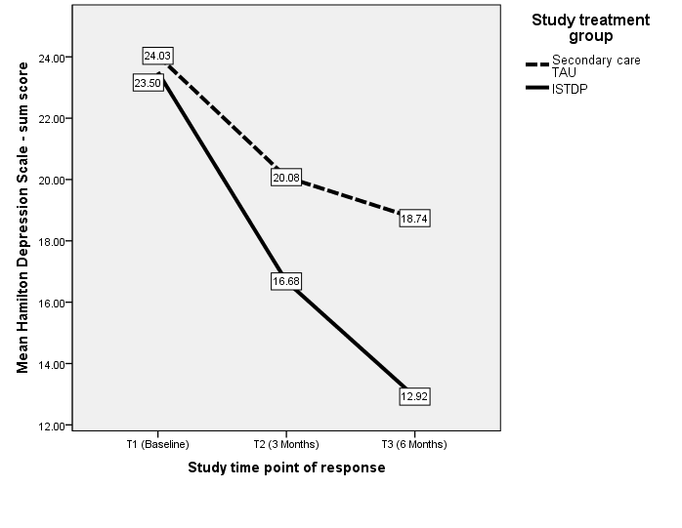
Efficacious with refractory patient groups: 11 studies. Treatment Resistant Depression RCT: 16 sessions Town et al, 2017
3.7% Full Remission
36% Full Remission

Slide 9
Condition (Reference) | Study Type | Number Cases | Outcome
Urethral Syndrome/ Pelvic Pain (1) | RCT | 36 | ISTDP > Medical TAU
Mixed MUS (2) | Case Series | 29 | Sig symptom reduction
Back Pain (3) | Case Series | 47 | Sig Pain Reduction
Functional Movement Disorders (4) | Case Series | 9 | Sig Symptom Reduction
Chronic Headache (5) | Case Series | 29 | Sig Symptom and cost reduction
Pseudoseizures (6) | Case Series | 28 | Sig symptom and cost reduction
Chronic Pain (7) | RCT | 63 | ISTDP> Mindfulness Based Stress Reduction and TAU
Chronic Pain (8) | RCT | 81 | ISTDP in person > Skype
Chronic Pain (9) | RCT | 100 | ISTDP by Skype > TAU
Irritable Bowel Syndrome (10) | RCT | 102 | ISTDP > Medical TAU
MUS in Emergency (11) | Controlled | 77 | Sig reduction pre post and vs referred control.
Mixed MUS + (12) | Controlled | 890 | Sig health cost and symptom reduction vs referred control
Atopic Dermatitis (13) | RCT | 32 | ISTDP> Ctrl in Anxious Cases
Bruxism (14) | RCT |  | Reduced use of bite plates
Functional Neurological (15) | Case Series | 11 | Improvement on multiple domains
Mixed MUS in Family Practice (16) | Case Series | 37 | Sig symptom improvement
Chronic Pain (39) | RCT | 341 | Sig symptom effects ISTDP=CBT

Slide 10
Efficacious for Chronic Pain
Chavooshi et al, 2016

Slide 11
21 Cost Based Outcome Studies of ISTDP
Spectrum of conditions including somatic symptoms
High rates of return to work (70-80% average) even from wcb, long term disability
70% drops in emergency use
25-50% drop in doctor use
Up to 85% drop in hospital use

Slide 12
Total Doctor and Hospital Costs/ patient: N=890, 7.3 Sessions Abbass, Kisely, Rasic, Town and Johansson 2015, J Psychiatric Research
17X cost offset
Normal Population Costs

Slide 13
Patients with Pseudoseizures N=28, 3.6 sessions of ISTDP Russell et al, 2016
Hospital Costs
Doctor Costs
Normal
Population

Slide 14
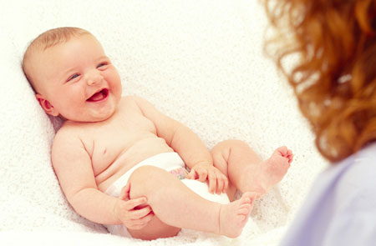
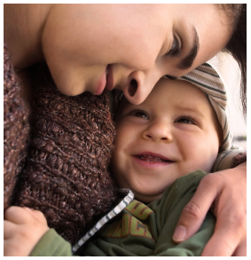
BOND
With
Parents
BOND
With
Others

Slide 15
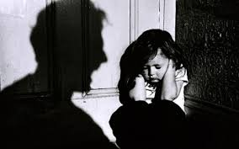
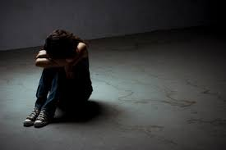
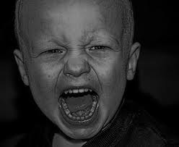
BOND
With
Parents
Trauma
PAIN
FEAR
Rage, Guilt
about the Rage
Intergenerational
Transmission of Trauma
Avoid closeness
Depression
Character Disorder
Somatic Symptoms

Slide 16
Transference
(Therapist/
Doctor)
Current
person
Past
person
Notes:
New 1.2

Slide 17
Unconscious
Defense
Unconscious
Anxiety
Unconscious
Impulses & Feelings
Notes:
2.1

Slide 18
Build your own Exposure model for “Phobia of Emotional Closeness and the somatic experience of feelings”
What is the exposure to?
What are the avoidant responses that need to be prevented?
How to align with the patient to face what they have avoided since childhood: closeness and intimacy, self awareness, self care and the somatic experience of feelings?
What feelings arise when you do such an exposure and response prevention?

Slide 19
Complex Transference Feelings (CTF)
Feelings mobilized by trying to therapeutically attach to patient
= appreciation plus irritation toward the therapist
Linked to the past bond, trauma, pain, rage and guilt about rage.

Slide 20
Unconscious Therapeutic Alliance
The unconscious healing force
A function of limbic memory and other centers
Mobilized by activating the complex transference feelings
Brings mental images of past relational trauma and clear linkages to trauma

Slide 21
Mid rise
in CTF
High rise
in CTF
Partial
unlocking
Major
unlocking
R >> UTA
Whispers from
the alliance: concise
understanding
of dynamics
R > UTA
Negation, slips of the tongue
R < UTA
Rage, grief:
clear linkages
R << UTA
Rage and Guilt: image transfer
R= Resistance
UTA+ Unconscious Therapeutic Alliance
Notes:
4.1

Slide 22
Unconscious Anxiety and defenses = somatization
Striated Muscle: Voluntary muscle tension
See with isolation of affect/ self reflection of affect
Smooth Muscle: Body organs
See with Repression
Cognitive –perceptual Disruption
See with primitive defenses
Motor Conversion
See with Repression

Slide 23
Initiating ISTDP: Steps
1. Handle barriers to engagement
2. Find the Front of the System
3. Psychodiagnosis
4. Intervene based on anxiety/defense/dynamic parameters
These will determine next interventions, pace and expected processes

Slide 24
Find the front and intervene
Front | Interventions
Avoided Feelings | Press to identify and feel the feelings
Unconscious Anxiety | Press to feelings if striated muscle Reduce anxiety if smooth muscle or Cognitive disruption formats
Unconscious Defenses | Press against defense, clarify and challenge the defense
No Signals | Search for the Defenses

Slide 25
Psychodiagnosis
2. Monitor Anxiety &
Defense responses
Unconscious
Defense
Unconscious
Anxiety
1. Encourage to be
Present with all
Feelings
Unconscious
Impulses & Feelings
Notes:
NEW 6.1

Slide 26
Avoid feeling
the feelings → Low Resistance
Become tense and
avoid You! → Moderate and High Resistance
4 Response
Patterns
Become tired, weak,
depressed or sick in body → High
Resistance with Repression
Become confused,
lose senses and
become afraid → Fragile
Character Structure

Slide 27
Spectrum of Psychoneurotic Disorders
Spectrum of Patients with Fragile Character Structure
Low Resistant
Moderate Resistant
Highly Resistant
Severe/ Borderline
Mild
Moderate
Striated Muscle + Isolation of affect
Smooth Muscle/Conversion + Repression
Cognitive-Perceptual Disruption + Primitive Defenses
Notes:
3.1

Slide 28
Spectrum of Psychoneurotic Disorders
Spectrum of Patients with Fragile Character Structure
Low Resistant
Moderate Resistant
Highly Resistant
Severe/ Borderline
Mild
Moderate
Grief
Violent/murderous rage/guilt
Primitive murderous rage/guilt
Primitive torturous rage/ guilt/craving bonds
Notes:
3.1

Slide 29
Moderate resistant patient
Have murderous rage and guilt and grief
Anxiety is striated muscle
Main defense is intellectualization /isolation of affect

Slide 30
Unlocking of the Unconscious Moderate Resistance
Pressure and limited challenge→ Complex Transference Feelings are experienced→ anxiety and defence are removed or reduced
Unconscious Therapeutic Alliance becomes higher than resistance
Linkages and Images of the unconscious emerge
Exploration with experience of feelings
Recap and treatment planning
Short course up to 10 meetings

Slide 31
Resistance
Mid rise:
Resistance crystallizing in
transference.
Clarify and
Challenge
Complex
Transference
feelings
“Unlocked”
Unconscious
therapeutic
alliance
Low rise:
inquiry and
pressure
Notes:
8.1

Slide 32
Pressure: Encourage healthy actions
All efforts encouraging the patient to do something healthy
Cementing the Bond
Reaching to the person stuck under the resistances
Pressure should target front of the system

Slide 33
Mid Rise
Resistance
Mid rise:
Resistance crystallizing in
transference.
Clarify and
Challenge,
Maintain pressure
“Unlocked”
Complex
Transference
feelings
Unconscious
therapeutic
alliance
Notes:
8.1

Slide 34
Clarification: Question unhealthy behaviors
Examples:
Pointing out
Questioning
Exploring impact of defense
Keep up pressure

Slide 35
Challenge: help patient to stop destructive actions
Interrupting and Blocking Defenses
If you don’t detach, if you dont shut down
Challenge is always done in concert with the patient and the growing UTA
Challenge is always done while maintaining Pressure

Slide 36
Partial Unlocking
Resistance
HELP EXPERIENCE THE FEELINGS
“Unlocked”: Emotion and Memory Function
Greater than inhibitory functions
Complex
Transference
feelings
Unconscious
therapeutic
alliance
Notes:
8.1

Slide 37
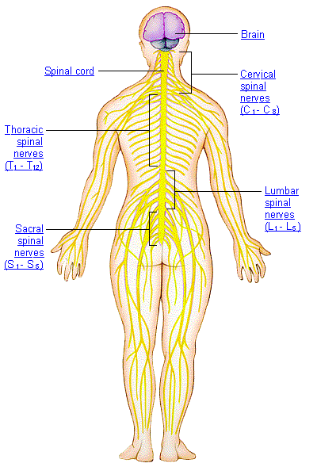
Striated Muscle
Anxiety
Goes Down Body
Neurobiological
Pathway of
Rage: goes up same
system displacing
anxiety
AMA Atlas online

Slide 38
Breakthrough
Partial Unlocking: vivid link to past person.
Major Unlocking: Image of current person or therapist changes to past person with passage of guilt.
Extended unlocking: Rage starts with the therapist then the image becomes the past person with major passage of guilt

Slide 39
Unlocking and Symptom changes with Trial Therapy N=500 Abbass, Town, Ogrodniczuk, Joffres, 2017
ES= 0.28
ES= 0.91

Slide 40
Unlocking vs Interpersonal problem changes with Trial Therapy N=500. Abbass, Town, Ogrodniczuk, Joffres, 2017
ES= 0.12
ES= 0.37

Slide 41
Trial Therapy Cost Effects n=344 Abbass, Kisely and Town, 2018 Psychotherapy and Psychosomatics
Normal population

Slide 42
Experiencing these unprocessed feelings about attachment trauma is diagnostic and therapeutic

Slide 43
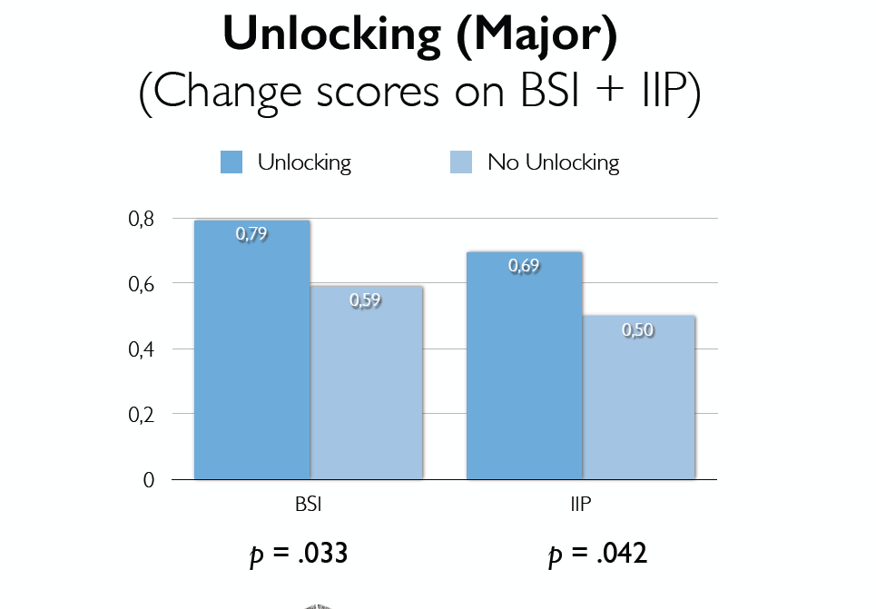
Impact of Major Unlocking during Treatment Course
Mixed sample tertiary refractory patients N=500.
Johansson, Town, Abbass 2014

Slide 44
Impact of Major Unlocking on Healthcare Costs
Impact of Major Unlocking
**
Town, Abbass and Bernier, Am J Psychotherapy 2013

Slide 45
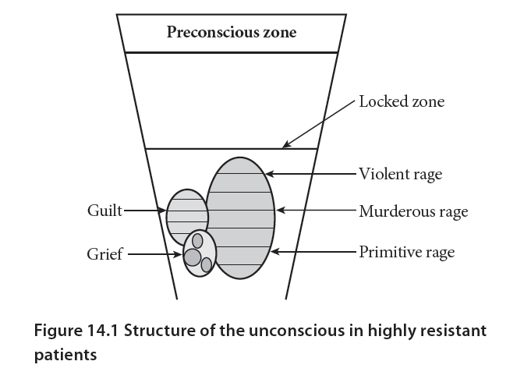

Slide 46
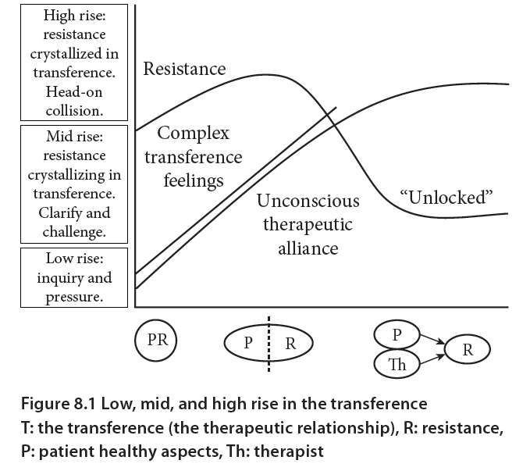

Slide 47
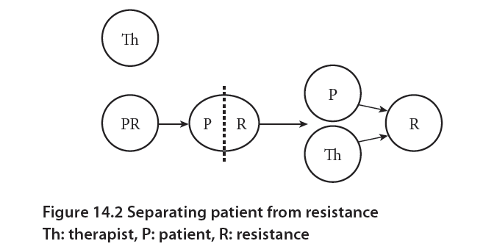

Slide 48
Complete
treatment
in 1 or 2 sessions
Inquiry
Breakthrough
of grief about loss
Low
Resistance
Resistance Rises
Striated muscle anxiety
plus feel complex transference feelings
Pressure
Moderate
Resistance
Repeated unlocking,
working through,
termination
Resistance crystallizes
in the transference
Striated muscle anxiety
plus feel complex transference feelings
Clarify,
Challenge,
Head on Collision
High
Resistance
Depression, smooth
muscle anxiety or motor conversion
High Resistance
with Repression
Capacity
Building
Formats
GO FLAT: No striated muscle anxiety, poor ability to reflect
Cognitive-perceptual
disruption or
primitive defenses
Fragile Character
Structure
Notes:
6.2

Slide 49
Avoid feeling
the feelings → Low Resistance
Become tense and
avoid You! → Moderate
and High Resistance
4 Response
Patterns from
psychodiagnosis
Become tired, weak, depressed
or sick in body → High Resistance
with Repression
Become confused,
lose senses and
become afraid →
Fragile Character Structure

Slide 50
Resistant Patient with Repression
Go Flat instead of defending or feeling feelings
Anxiety to smooth muscle OR Motor Conversion OR Depression/fatigue
Tend to alternate between these
Lack ability to reflect on feelings

Slide 51
Repression case Chapter 14
Chronic depression
Irritable Bowel, Migraines
Weakness
Social Problems, long term disability, divorcing
2nd session and some of 4th session

Slide 52
Conscious
Feelings
Threshold to experiencing impulse/feelings
Threshold to Repression
Striated Muscle Anxiety
Isolation of Affect
Unconscious
Anxiety
Severe
Repression
Moderate
Repression
Mild
Repression
Notes:
15.1

Slide 53
Conscious
Feelings
Threshold to Repression
3
2
3
1
2
Striated Muscle Anxiety
Isolation of Affect
Unconscious
Anxiety
1
1. Pressure to feelings or to defenses
2. Rise in complex transference feelings
3. Intellectual recap to bring isolation of affect
Notes:
15.2

Slide 54
Conscious
feelings
Pressure
Rise in CTF
Recap
Threshold to Repression
3
3
2
2
1
Unconscious
anxiety and
defense
1
Isolation of affect
Striated muscle
Therapeutic window
Severe
Moderate
Mild
Notes:
FIGURE16.3

Slide 55
UTA RISES WITH CTF
Conscious
Feelings
Threshold
CTF
Unconscious
Anxiety
UTA
Notes:
15.3

Slide 56
Somatic pathways of feeling: rage, guilt, grief
Love: rising warmth, urge to smile and embrace
Rage: rising heat/energy up chest to head then down arms: tension, anxiety and symptoms drop or stop
Guilt about rage: Hard solid waves, pain in upper chest. Feel as if, for example, have just murdered loved one.
Grief: tears, painful feeling in chest. Waves not as hard and distinct as guilt. Not as loud or painful.

Slide 57
Avoid feeling
the feelings → Low Resistance
Become tense and
avoid You! → Moderate and
High Resistance
4 Response
Patterns from
psychodiagnosis
Become tired, weak,
depressed
or sick in body → High Resistance
with Repression
Become confused,
lose senses and become afraid →
Fragile Character Structure

Slide 58
Fragile Character Structure Patients
Early neglect, abuse, invalidation
Absence of parental figure with anxiety tolerance: usually fragile parents project on child
Cognitive-perceptual disruption at some level of rise in anxiety
Projection, splitting, projective identification
Need capacity building
Anxiety to striated/voluntary muscle
Defense to self reflection on feelings/isolation of affect

Slide 59
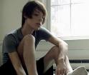
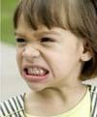
WEAK
BOND
Trauma
PAIN
Rage, Guilt
about the Rage
Self-destruct
Symptoms

Slide 60
Rapidly Rotating Fronts
Cognitive Perceptual Disruption
Self attack or seek
punishment
Projection: Afraid
Repression: Flat, weak, depressed

Slide 61
Projective Identification
Projection
Cognitive Perceptual
Disruption
Repression
Smooth Muscle
Isolation of affect
Striated Muscle
Severe Fragile
Borderline
Moderate Fragile
Mild Fragile
Notes:
16.2

Slide 62
Capacity building Phase
Psychic integration
Graded format
Anxiety tolerance
Voluntary muscle anxiety and reflective capacity
Start to mobilize the UTA
Maybe few sessions to 25 sessions or more depending on level of fragility

Slide 63
Conscious
Feelings
Threshold to CPD or primitive defenses
3
2
3
1
2
Striated Muscle Anxiety
Isolation of Affect
Unconscious
Anxiety
1
1. Pressure to feelings or to defenses
2. Rise in complex transference feelings and anxiety
3. Intellectual recap to bring isolation of affect
Notes:
15.2

Slide 64
Conscious
feelings
Pressure
Rise in CTF
Recap
Threshold to CPD or primitive defenses
3
3
2
2
1
Unconscious
anxiety and
defense
1
Isolation of affect
Striated muscle
Therapeutic window
Severe fragile,
borderline
Moderate
fragile
Mild
fragile
Notes:
FIGURE16.3

Slide 65
UTA RISES WITH CTF
Conscious
Feelings
Threshold
CTF
Unconscious
Anxiety
UTA
Notes:
15.3

Slide 66
Conscious
Feelings
3
1
Threshold
Unconscious
Anxiety
2
Notes:
15.3

Slide 67
Therapist activity with FCS
Non judgmental stance
Focus
Press or brace
Clarify phenomena
Recap
Reduce anxiety
Engage partner to monitor and examine
Stay out of shoes: deal with projections
Monitor front, rise, anxiety pathways
SELF REFLECT ON BODY AND FEELINGS

Slide 68
Projective Identification
Projection
Cognitive Perceptual
Disruption
Repression
Smooth Muscle
Isolation of affect
Striated Muscle
Severe Fragile
Borderline
Moderate Fragile
Mild Fragile
Notes:
16.2

Slide 69
Results of Capacity Building Phase
Anxiety in striated muscle
Ability to self reflect
Ability to reduce own anxiety
Understanding of the trauma
Reduction of paranoia
Start to have Repeated Unlocking

Slide 70
Projective Identification
Projection
Cognitive Perceptual
Disruption
Repression
Smooth Muscle
Isolation of affect
Striated Muscle
Severe Fragile
Borderline
Moderate Fragile
Mild Fragile
Notes:
16.2

Slide 71
Projective Identification and Symptom Formation: Sympathy symptoms
Patient experiences what the rage wanted to do to others
Choking: rage to strangle
Eye pain: rage to damage eyes
Head pain: rage to damage head
Symptom is removed by experience of the guilt about the rage

Slide 72
Projective Identification
Projection
Cognitive Perceptual
Disruption
Repression
Smooth Muscle
Isolation of affect
Striated Muscle
Severe Fragile
Borderline
Moderate Fragile
Mild Fragile
Notes:
16.2

Slide 73
Rapidly Rotating Fronts
Cognitive Perceptual Disruption
Self attack or seek
punishment
Projection: Afraid
Repression: Flat, weak, depressed

Slide 74
Psychic Integration
Projective Identification
Projection
Cognitive Perceptual
Disruption
Repression
Smooth Muscle
Isolation of affect
Striated Muscle
Severe Fragile
Borderline
Moderate Fragile
Mild Fragile
Notes:
16.2

Slide 75
Self Escalation in severe fragile and psychosis
Guilt about rage
is repressed
Rage
about
the attack or
punishment
Projection
of rage or
punishment
Fear attack or
punishment

Slide 76
Conscious
feelings
Pressure
Rise in CTF
Recap
Threshold
3
3
2
2
1
Unconscious
anxiety and
defense
1
Isolation of affect
Striated muscle
Therapeutic window
Severe fragile,
borderline
Moderate
fragile
Mild
fragile
Notes:
FIGURE16.3

Slide 77
Unlockings in previously fragile cases
Break through the defense of repression, not through character defenses
Cleaner process in some ways
Repeated extended unlockings: long passage of rage and guilt/grief
Rage at times has torturous impulse with huge guilt
Emergence of empathy for victim and love

Slide 78
Parallels between CBT and ISTDP
Pressure = identify assumptions and beliefs
Clarification: to explore cognition, Cost benefit analysis, Reality Testing
Switching thoughts = ~ challenge
Behavioral analysis = recapitulation of links
Identifying cycles and reviewing them
Exposure = can mobilize the unconscious and lead to breakthroughs
Graded exposure = Graded Format
Response prevention = ~ Challenge

Slide 79
Differences vs Traditional CBT
Conscious vs unconscious anxiety
Effects will not tend to generalize in complex cases using traditional CBT exposure
Thus high resistant and fragile cases don’t respond well to exposure or any other guided therapies alone
Work in the therapy relationship here and now: ISTDP
Homework and suggestions: CBT, not in ISTDP
Handling resistance
Dealing with mobilized rage and guilt in the process

Slide 80
Courses and training in ISTDP
All course information http://reachingthroughresistance.com/upcoming-events/
Danish 3 day Annual immersion: August 2019 http://reachingthroughresistance.com/wp-content/uploads/2018/04/FlyerAbbassAug2018eng.pdf
Danish Supervision: https://istdp-danmark.dk/istdp-undervisere-2/
Halifax Canada Annual Immersion www.allanabbass.com

Slide 81
R >> UTA
Whispers from
the alliance: concise
understanding
of dynamics
R << UTA
Rage and Guilt: image transfer
R > UTA
Negation, slips of the tongue
R < UTA
Rage, grief:
clear linkages
Threshold
Conscious
feelings
Guilt
Rage
Unconscious
anxiety and
defense
Grief
Notes:
FIGURE16.3

Slide 82
Repeated Unlocking Phase
In longer cases, phase is a year or more long
Repeated partial then major unlocking of the unconscious
Draining the pathogenic reservoir of rage and guilt
Mobilizing positive feelings which mobilizes more rage and guilt
In longer term case maybe 2-300 unlockings
Notes:
session

Slide 83
Modified ISTDP for Psychotic Disorders
Most patients with psychosis are fragile at baseline: it is treated as per fragility
Medications can help them tolerate therapy
Focus on capacity building
A supportive format: little to no challenge
Recapping > Bracing > Pressing
Psychodiagnosis each session
Keep anxiety at tolerable level

Slide 84
Results of Capacity Building Phase
Anxiety in striated muscle
Ability to self reflect
Ability to reduce own anxiety
Understanding of the trauma
Reduction of paranoia/projection and grief about it
Emerging empathy for family

Slide 85
Projective Identification and Symptom Formation: Sympathy symptoms
Patient experiences what the rage wanted to do to others
Choking: rage to strangle
Eye pain: rage to damage eyes
Head pain: rage to damage head
Strange sensations: rage to cause same sensations: e.g. electricity through body
Symptom is removed by experience of the guilt about the rage
Very common phenomenon in fragile patients

Slide 86
UTA in Repeated Unlocking
Spontaneous unlockings in week
Imagery pops in head
Dead bodies
Sensations in body
Dreams that are breakthroughs
Vivid content allow strong guilt to be felt
Sense of Presence: UTA
Notes:
Session 70 mov 13 2014

Slide 87
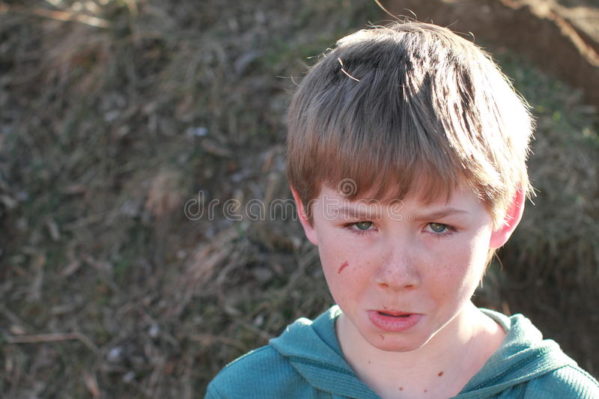
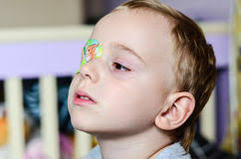
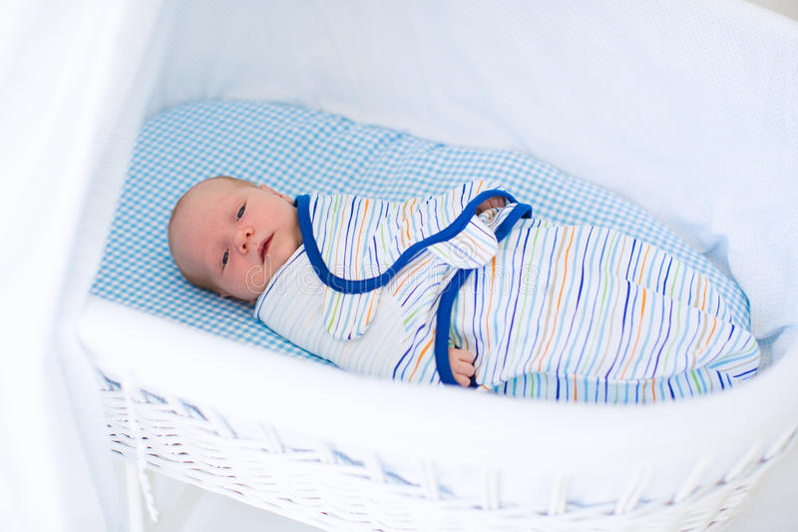
Trends in unlockings
Get less to more intense
Go from later in development to earlier to infancy
Go from primitive to more torturous rage
Early rage is more jaw (baby)
With each breakthrough of rage and guilt there is more capacity for compassion and love.

Slide 88
Results of repeated unlocking phase
Next to no signs of fragility
Emotions are separated: de-fused
Compassion for self
Empathy and love for others: survivor guilt
Grief about psychopathology
Functional gains
Growing mastery of psychodynamics
Altruism: wish to give to others

Slide 89
Working Through Phase
Mobilization of grief and self compassion as guilt is removed
De fusion of punitive superego from self
Drives for attachment
Healthy activity in life
Return to function
Pockets of rage and guilt still emerge
Grief is dominant
Empathy/love for family members
Notes:
Session 140 march 10 2017

Slide 90
Course of Time Limited ISTDP
Capacity
Building
Partial
Unlocking
Termination
Start
20 sessions
End

Slide 91
Termination Phase
In longer term cases phase is several months long
Looking ahead in life
Functioning or on the way
Looking to intimate relationships
Empathy and guilt about leaving family behind
Grief about loss of therapist
Grief about past losses
Maybe few pockets of rage and guilt but mostly grief
Goodbye

Slide 92
Principles of ISTDP for Dissociative Disorder
Build anxiety tolerance in main adult states
Graded format, bracing, lot of recapping/ linking to bolster adult state
Then build bridges across states: especially adult core to younger parts
Patient will tend to drift and project with that effort
Help them further build capacity
First breakthroughs → better ability to hold awareness of links between parts and feel the feelings about past trauma

Slide 93
Smooth
Muscle
Self-
attack
CPD
Splitting
CPD
Repression
Projection
Self-
attack
Projective
Identification
Striated Muscle Anxiety
Isolation of Affect

Slide 94
 | Resistant | Repression or Fragile
Low Rise | Little anxiety or defense: some tension and isolation of affect | Tension and isolation of affect
Mid Rise | Defenses going into the T, Tense, UTA Whisper | Start to oppose repression or fragility, anxiety varies, UTA: Whisper
High rise | Defenses in the T, Tense, UTA: negation | Dislike the repression or fragility, anxiety varies, one part of mind fighting the other: UTA Negation
Partial Unlocking | Feel grief rage and some guilt. Link or image of past | Feel grief rage and some guilt. Link or image of past
Major Unlocking | Feel rage, guilt and grief. Image transfers with passage of guilt | Feel rage, guilt and grief. Image transfers with passage of guilt

Slide 95
Threshold
Conscious
feelings
Guilt
Rage
Unconscious
anxiety and
defense
Grief
Notes:
FIGURE16.3

Slide 96
R >> UTA
Whispers from
the alliance: concise
understanding
of dynamics
R << UTA
Rage and Guilt: image transfer
R > UTA
Negation, slips of the tongue
R < UTA
Rage, grief:
clear linkages
Threshold
Conscious
feelings
Guilt
Rage
Unconscious
anxiety and
defense
Grief
Notes:
FIGURE16.3

Slide 97
Complete
treatment
in 1 or 2 sessions
Inquiry
Breakthrough
of grief about loss
Low
Resistance
Resistance Rises
Striated muscle anxiety
plus feel complex transference feelings
Pressure
Moderate
Resistance
Repeated unlocking,
working through,
termination
Resistance crystallizes
in the transference
Striated muscle anxiety
plus feel complex transference feelings
Clarify,
Challenge,
Head on Collision
High
Resistance
Depression, smooth
muscle anxiety or motor conversion
High Resistance
with Repression
Capacity
Building
Formats
GO FLAT: No striated muscle anxiety, poor ability to reflect
Cognitive-perceptual
disruption or
primitive defenses
Fragile Character
Structure
Notes:
6.2

Slide 98
Reflection: Recap
Pressure
BRACING
Use when below thresholds
Evoke feelings
Activate somatic
pathway of rage
Develop images
Fire limbic areas including amygdala
Use to optimize rise without being over threshold
Combine both self-reflection and pressure
Train brain to fire both functional regions together
Use when above thresholds
Self-reflect
Link phenomena
Observe the body
Observe thoughts
Fire brain self- reflective centers
Abbass, Reaching Through
Resistance, 2015
Notes:
15.4

Slide 99
Conscious
feelings
CPD primitive defenses
or repression
RECAP and ANXIETY REDUCING TECHNIQUES
BRACING
Unconscious
anxiety and
defense
PRESSURE
Isolation of affect
Striated muscle
Severe fragile,
borderline
Moderate
fragile
Mild
fragile
Notes:
FIGURE16.3

